Slide 1

SIGGRAPH 2010 Course
Spectral Mesh Processing
Bruno Lévy and Hao (Richard) Zhang

Slide 2
Spectral mesh processing
Use eigenstructures of appropriately defined linear mesh operators for geometry analysis and processing
Spectral = use of eigenstructures

Slide 3
Eigenstructures
Eigenvalues and eigenvectors:
Diagonalization or eigen-decomposition:
Projection into eigensubspace:
DFT-like spectral transform:
Au = λu, u ≠ 0
A = UΛU^{T}
y’ = U_{(k)}U_{(k)}^{T}y
ŷ = U^{T}y

Slide 4
Outline
Overview
A gentle introduction
Laplacian smoothing
Fourier analysis for meshes
Discretizing the Laplace operator
Computing eigenfunctions
…

Slide 5
Outline
Overview
A gentle introduction
Laplacian smoothing
Fourier analysis for meshes
…

Slide 6
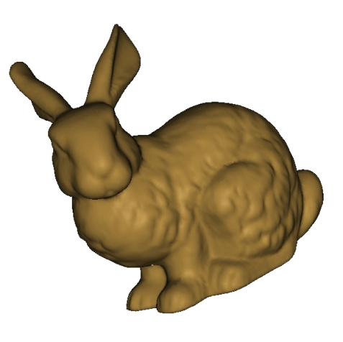

Overall structure
Input mesh M
Eigendecomposition: A = UΛU^{T}
A
=
U
Λ
U^{T}
e.g.
y’ = U₍₃₎U₍₃₎^{T}y
Mesh operator A
=

Slide 7
Basic Framework
Construct a matrix
An eigendecomposition of the matrix
Using the eigenstructure to obtain a solution

Slide 8
Basic Framework
Main Motivation:
The pursuit of Fourier analysis in the manifold setting,
Effective and information-preserving dimensionality reduction
Revealing global and intrinsic structures in geometric data.

Slide 9
Outline
Overview
A gentle introduction
Laplacian smoothing
Fourier analysis for meshes
…

Slide 10
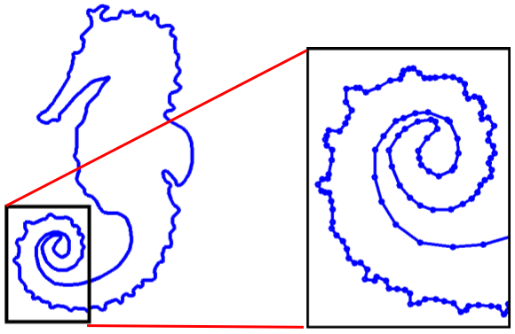

The smoothing problem
Smooth out rough features of a contour (2D shape)

Slide 11

Midpoint smoothing
repeatedly connect the midpoints of successive contour segments

Slide 12
Outline
Overview
A gentle introduction
Laplacian smoothing
Fourier analysis for meshes
…

Slide 13
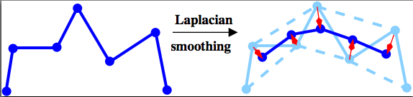

Laplacian smoothing
Move each vertex towards the centroid of its neighbours
Here:
  Centroid = midpoint
  Move half way

Slide 14
Smoothing result
Obtained by 10 steps of Laplacian smoothing

Slide 15
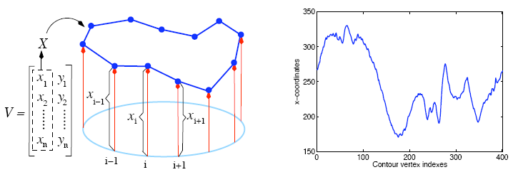
Signal representation
Represent a contour using a discrete periodic 2D signal
x-coordinates of the seahorse contour

Slide 16
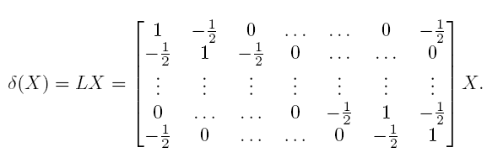
1D discrete Laplacian operator
Laplacian Operator

Slide 17
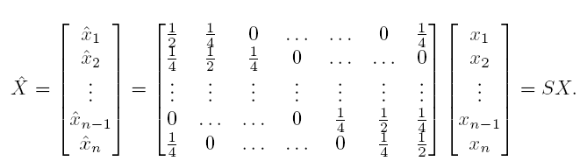

Laplacian smoothing in matrix form
x component only
y treated same way
Smoothing operator
Smoothing and Laplacian operator:

Slide 18
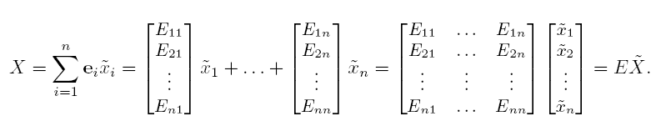


Spectral analysis of signal/geometry
Express signal X as a linear sum of eigenvectors
DFT-like spectral transform
X
Project X along eigenvector
Spatial domain
Spectral domain

Slide 19
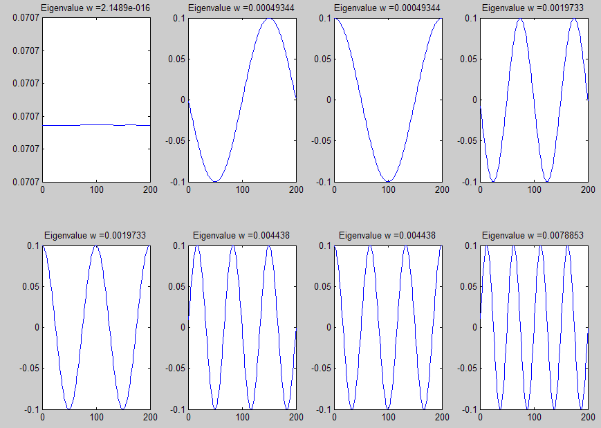
Plot of eigenvectors
First 8 eigenvectors of the 1D Laplacian
More oscillation as eigenvalues (frequencies) increase

Slide 20
Relation to DFT
Smallest eigenvalue of L is zero
Each remaining eigenvalue (except for the last one when n is even) has multiplicity 2
One particular set of eigenvectors of L are the DFT basis
Both sets exhibit similar oscillatory behaviours wrt frequencies

Slide 21

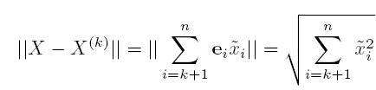
Reconstruction and compression
Reconstruction using k leading coefficients
A form of spectral compression with info loss given by L₂

Slide 22
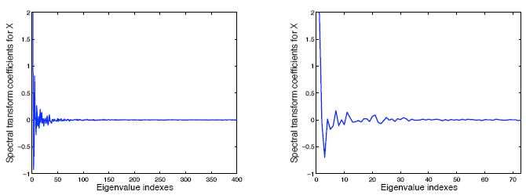
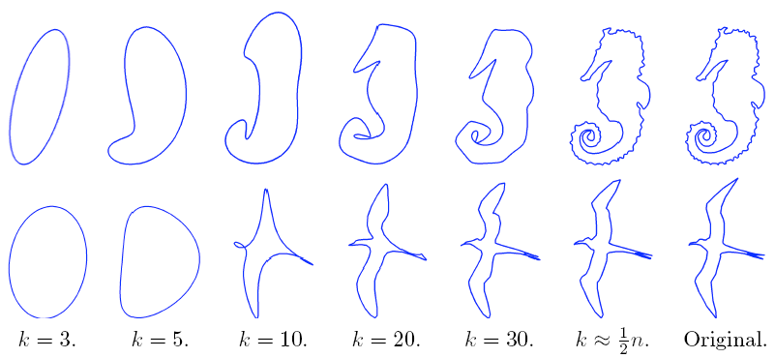
Plot of spectral transform coefficients
Fairly fast decay as eigenvalue increases

Slide 23
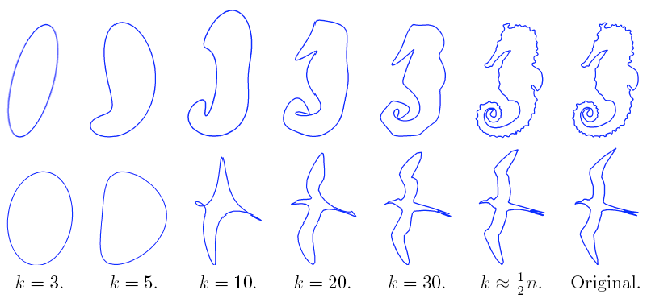
Reconstruction examples
n = 401
n = 75

Slide 24
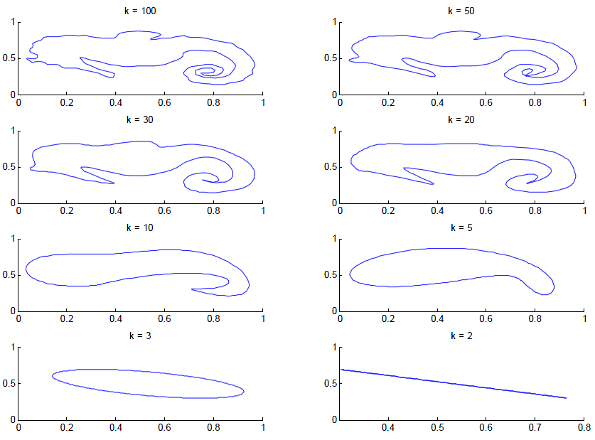

Slide 25

Laplacian smoothing as filtering
Recall the Laplacian smoothing operator
Repeated application of S
A filter applied to spectral coefficients

Slide 26


The limit behavior of Laplacian smoothing
Through the computing we can see that for all i.
Let , then ,and f(0) = 1.
As , except for f(0). At this time,
X^{(m)}are the center of the shape.

Slide 27
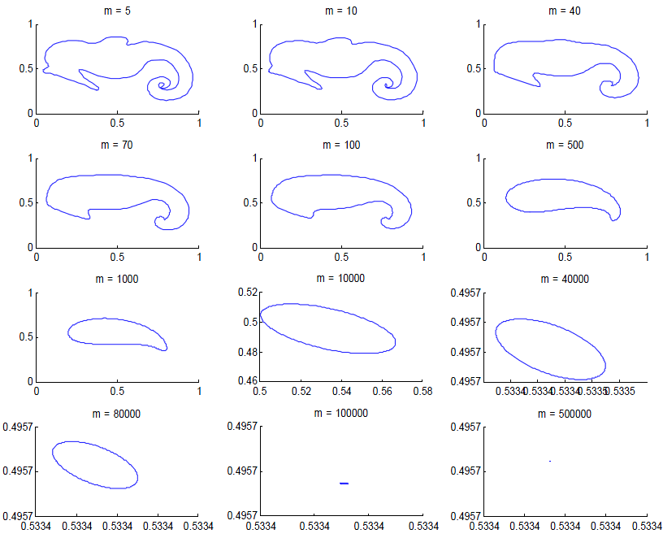

Slide 28
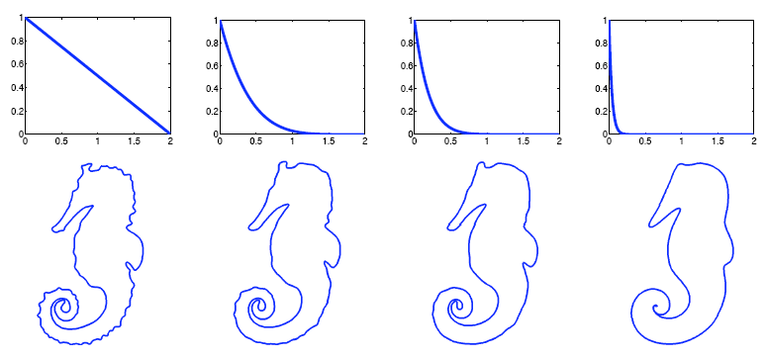

Examples
m = 1
m = 5
m = 10
m = 50
Filter:

Slide 29
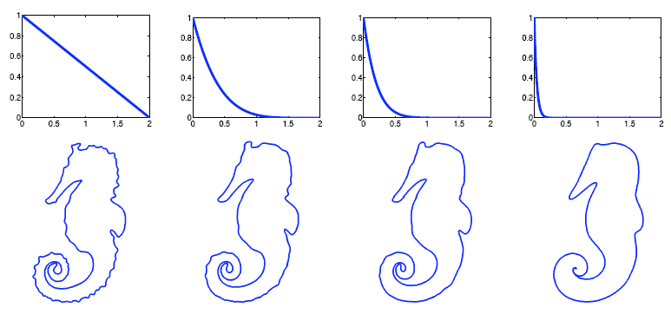
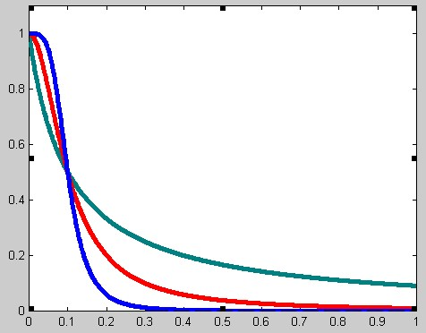

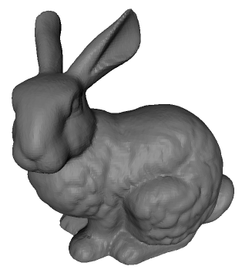
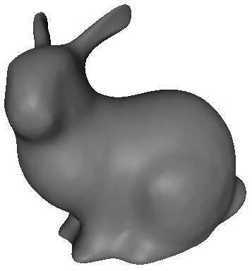
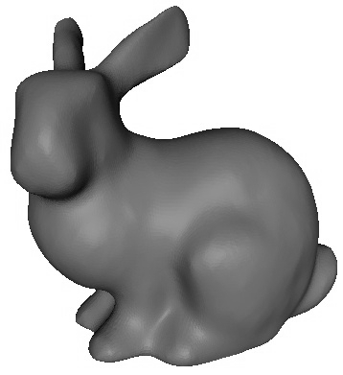
Aside: other filters
Laplacian
Butterworth

Slide 30

Spectral analysis vs. discrete Fourier transform
The definition of the discrete Fourier transform (DFT) ：
Discrete signal, it can be the component of vertex coordinates
DFT

Slide 31
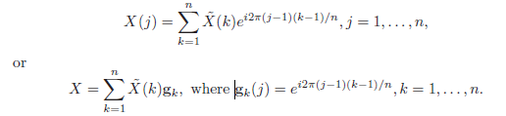
Spectral analysis vs. discrete Fourier transform(…)
And the corresponding inverse DFT is given by
DFT basis functions, the g_{k}’s, form a set of eigenvectors of the 1D discrete Laplace operator L. A proof of this fact can be found in “Fundamentals of Digital Image Processing”.

Slide 32

Spectral analysis vs. discrete Fourier transform(…)
Sorting the eigenvalues of L in ascending order, we can see that
Defining the matrix G:
the first column of G is an eigenvector corresponding to and the k-th and (n + 2 − k)-th columns of G are two eigenvectors corresponding to for k = 2, . . . , n.

Slide 33
Towards spectral mesh transform
Signal representation
  Vectors of x, y, z vertex coordinates
Laplacian operator for meshes-------main task
  Encodes connectivity and geometry
  Combinatorial: graph Laplacians and variants
  Discretization of the continuous Laplace-Beltrami operator ⎯ by Bruno
The same kind of spectral transform and analysis of 2D shape
(x, y, z)

Slide 34
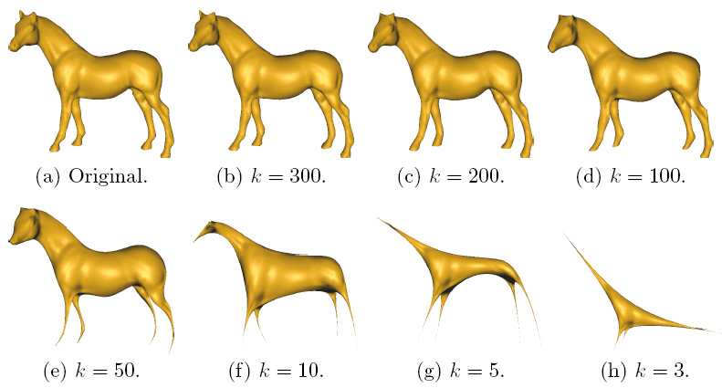
Spectral mesh compression

Slide 35
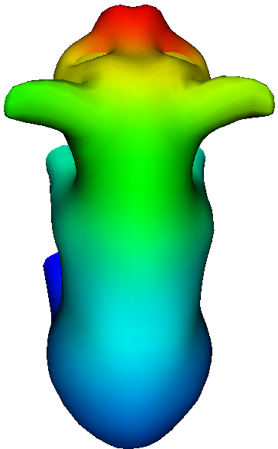
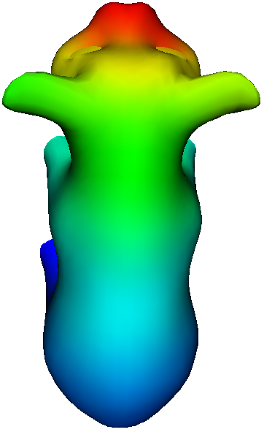
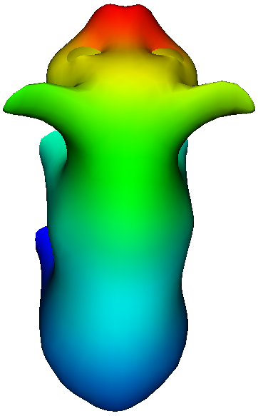
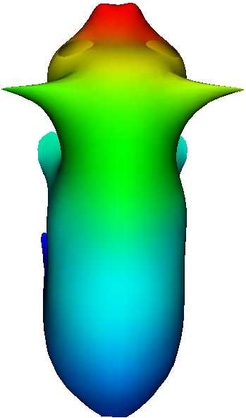
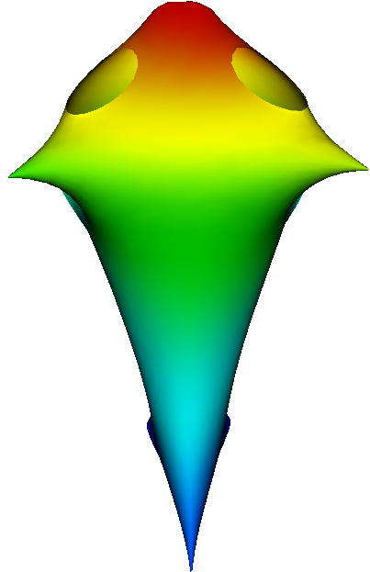
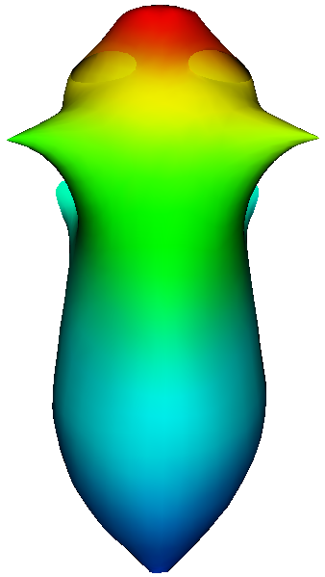
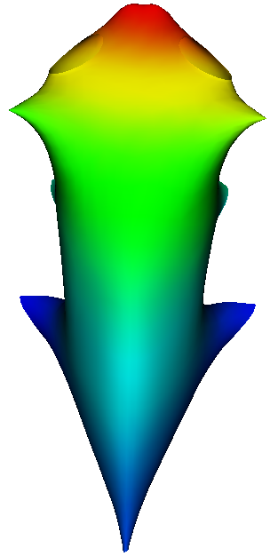
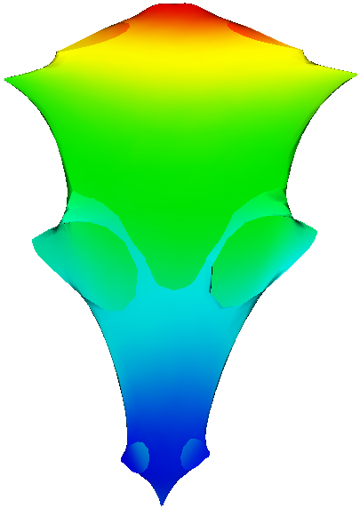
Spectral mesh compression
K = 400
K = 200
K = 100
K = 50
K = 10
K = 5
K = 4
K = 30
K = 5

Slide 36
Outline
Overview
A gentle introduction
Laplacian smoothing
Fourier analysis for meshes
…

Slide 37



Fourier Analysis
Given a square-integrable periodic function:
f can be expanded into an infinite series of sines and cosines of increasing frequencies:
…
”Circle harmonics” basis
Fourier Transform (FT) of f :

Slide 38

Fourier Analysis
We can consider the functions H^{k} of the Fourier basis as the eigenfunctions
of −∂²/∂x²: the eigenfunctions H^{2k+1} (resp. H^{2k+2}) are associated with the
eigenvalues (2kπ)²:

Slide 39
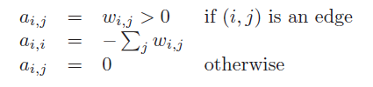
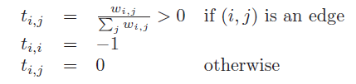
The discrete setting: Graph Laplacians
The Graph Laplacian L = (a_{i,j}) is a matrix defined by:
The Tutte Laplacian T = (t_{i,j}) is a matrix defined by:
The second eigenvector of the Tutte Laplacian is called the Fiedler vector

Slide 40

Fiedler Vector
The Fiedler vector u = (u₁ . . . u_{n}) is the solution of the following constrained minimization problem:
Properties:
It a good permutation vector for numerical computations; [Fie73, Fie75].
Application:
Finding natural vertices ordering for streaming meshes. [IL05]

Slide 41

The Continuous Setting: Laplace Beltrami
The Laplace operator (or Laplacian) plays a fundamental role in physics and mathematics. In R^{n}, it is defined as the divergence of the gradient:
The Laplacian generalizes the second order derivative to higher dimensions, and is a characteristic of the irregularity of a function as Δf(P) measures the difference between f(P) and its average in a small neighborhood of P.

Slide 42

Hilbert Spaces
Hilbert space —— the norm defined by
An inner product is given by
L₂ norm.
orthonormal
Defining a function basis (Φ_{i}),
a function f can be presented by:

Slide 43
Operators
An operator is a function of functions (i.e. from X to X). An eigenfunction of the operator L is a function f such that L f = λ f.
A linear operator L is said to be Hermitian, if < L f, g >=< f, L g> for each f, g ∈ X.
Property: Their eigenfunctions associated to different eigenvalues have real eigenvalues and are orthogonal.

Slide 44

Chladni plates(1787)
This behavior can be modeled as follows (wave propagation equation):
In Cartesian 2D space, the eigenfunctions are simply sin(Nx), cos(Nx) and the constant function, where N is an integer.

Slide 45
Eigenfunctions——protrusions and symmetries and the shape
Nodal sets —— the zero-set of an eigenfunction;
A nodal set partitions the surface into a set of nodal domains of constant sign.
The nodal sets and nodal domains are characterized by the following theorems:
The n-th eigenfunction has at most n nodal domains
the nodal sets are either at smooth curves or the curves intersecting at constant angles

Slide 46
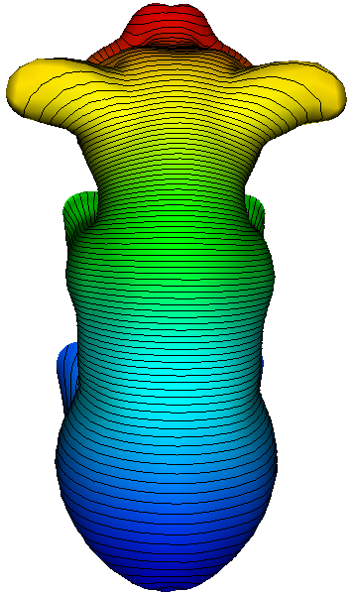
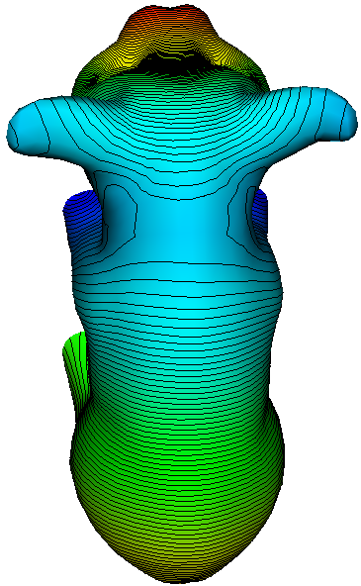
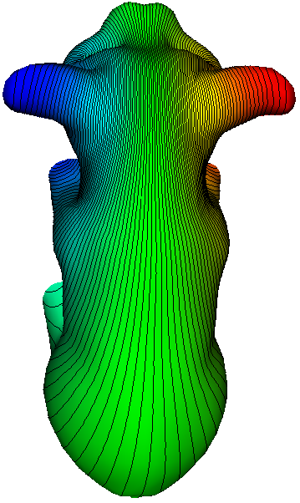
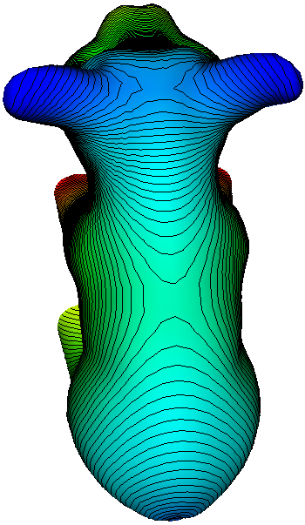
Nodal Sets and Nodal Domains

Slide 47
THE END

